Slide 1












ADVENTURE WORKS
P R E S E N T E D B Y
UTKARSH ARYA
HARINI M
SONALI SAKPAL
MANISHA

Slide 2








PROJECT OVERVIEW
The aim of this data analytics project is to analyze Adventure works sales data to uncover patterns, trends, and insights that can assist in improving Overall sales Regional performance, Identify sales trends , and customer targeting strategies. The project focuses on key performance indicators (KPIs) that provide a detailed understanding of sales behaviors across different segments.
To effectively visualize and interpret the data, we created interactive dashboards using the following tools:
Excel, Tableau, and Power BI . These dashboards allowed for a dynamic and detailed exploration of the data, providing actionable insights that can be easily communicated to stakeholders.

Slide 3
OBJECTIVE
Objective: The goal was to create an interactive and insightful tool that enables Adventure Works Cycles to monitor and enhance their sales strategies by identifying key trends and performance metrics across different regions, products, and customer segments.

Slide 4
OUR MODULES
EXCEL
SQL was used to query the
Excel was used for initial data cleaning,
relevant sales data for analysis.
Complex queries were written to filter, join, and aggregate data from multiple tables.
Data was cleaned and structured in SQL to ensure it was ready for further analysis in other tools.
Data modelling using power pivot.
Pivot tables and charts in Excel were employed to create quick visualizations of year-wise sales amounts and other KPIs.
TABLEAU
Power BI was used to develop interactive reports and dashboards.
The tool’s capabilities in handling large datasets and creating dynamic visuals.
Power BI's integration features allowed for combining data from various sources, enhancing the overall analysis.
A data visualization tool used for creating advanced visualizations and interactive dashboards.
Tableau's ability to create interactive visualizations helped in exploring the data more comprehensively and identifying hidden patterns.

Slide 5



KPI’S USED IN DASHBOARD
KPI-1: Year-wise sales amount.
KPI-2: Month-wise sales amount.
KPI-3: Quarter-wise sales amount.
KPI-4: Country-wise sales amount.
KPI-5: Gender- wise sales amount.
KPI-6: Month-wise sales and profit amount,

Slide 6


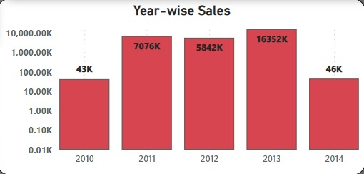

KPI-1 YEAR WISE SALES AMOUNT
A line graph that shows the **Year-wise sales Amount Statistics** for the years 2010 to 2014. The graph illustrates the sum of sales amounts issued each year.
Growth: The most significant increase occurred in 2013, indicating a rapid expansion in the sales portfolio during these year.

Slide 7

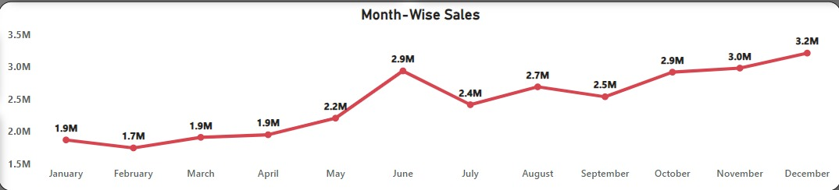
KPI- 2 MONTH WISE SALES AMOUNT
This graph shows the month wise sales amount status. The graph plots the number of sales amount across all the months from January to December. December saw peak sales (₹3.2M), driven by seasonal promotions, while February had the lowest, suggesting a need for targeted campaigns during off-peak months.

Slide 8

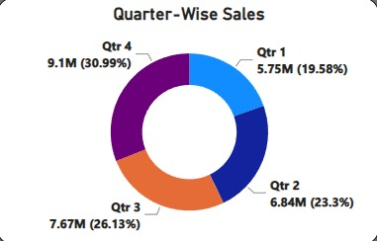
KPI-3 QUARTER WISE SALES AMOUNT
This is a donut chart illustrates the distribution of all four quarters.
Quarter 1: Jan, Feb, March Which has a sales amount of 5.75M(19.585).
Quarter 2: April, May, June which has a sales amount of 6.84M(23.3%).
Quarter 3: July, August, and September, which has a sales amount of 7.67M(26.13%).
Quarter 4: October, November, and December which has a sales amount of 9.1(30.99%) and this quarter has the highest sales amount compared to others.

Slide 9
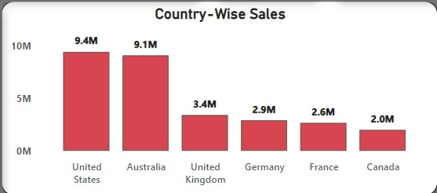
KPI-4 COUNTRY WISE SALES AMOUNT
+
The bar chart shows the country-wise sales amount. The United States and Australia are the top-performing countries, with sales of ₹9.4M and ₹9.1M, respectively. Whereas the UK, Germany, France, and Canada have the low sales amount compared to the US and Australia.

Slide 10
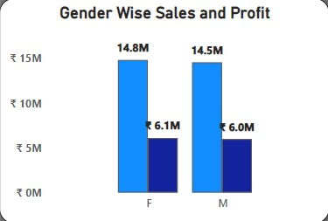
KPI-5 GENDER WISE SALES & PROFIT AMOUNT
This chart represents Gender-wise sales and profit amount. In Both female and male sales amount is high when compared to the profit amount.
Sales of female: 14.8M
Sales of Male: 6.1M
Profit of female: 14.5M
Profit of Male: 6.0M

Slide 11
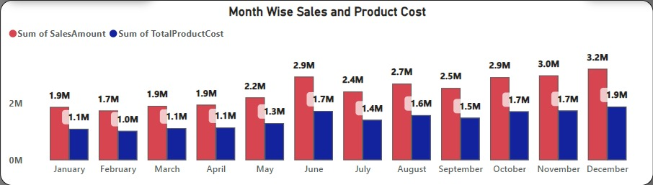
KPI-5 MONTH WISE SALES & PROFIT AMOUNT
This chart represents month-wise sales and product cost. We have represented sum of sales amount, sum of total product cost from Jan to December.
December month has the highest sum of sales amount and total product cost, whereas feb month has the lowest sales.

Slide 12
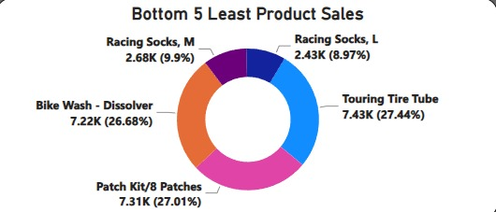
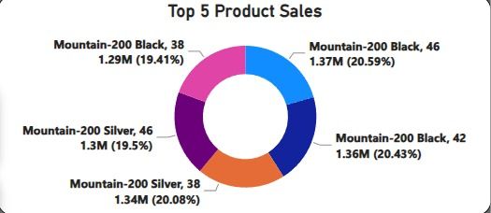
KPI-6 BOTTOM & TOP 5 PRODUCT SALES AMOUNT
T

Slide 13

DASHBOARDS

Slide 14


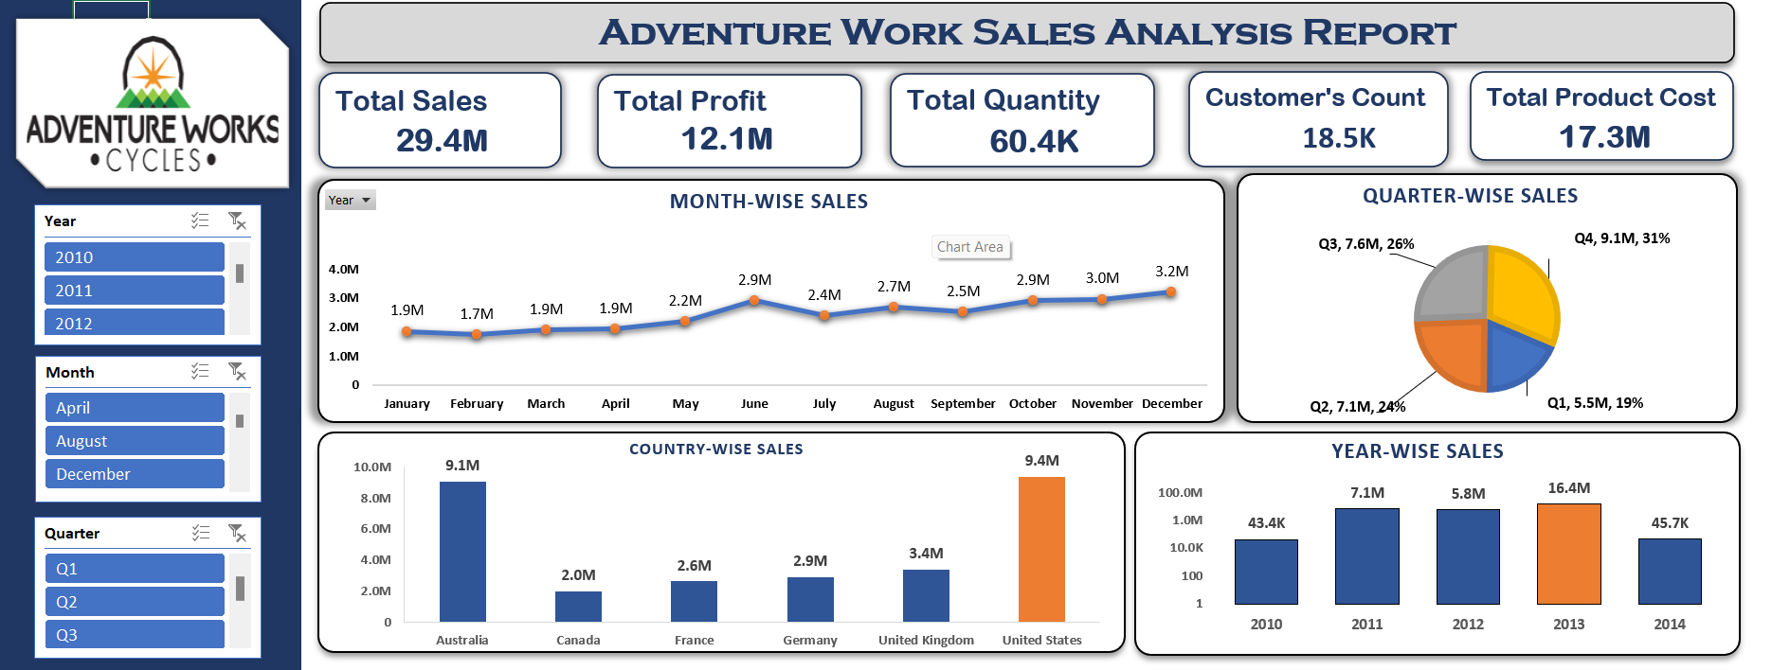
EXCEL DASHBOARD

Slide 15
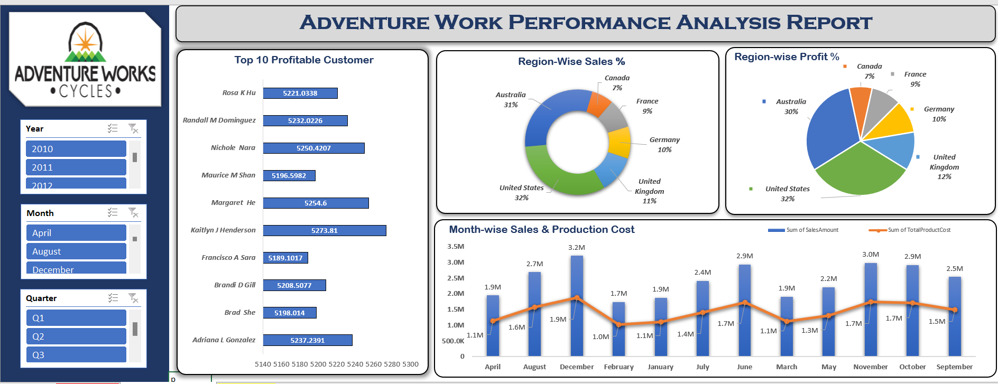
EXCEL DASHBOARD

Slide 16



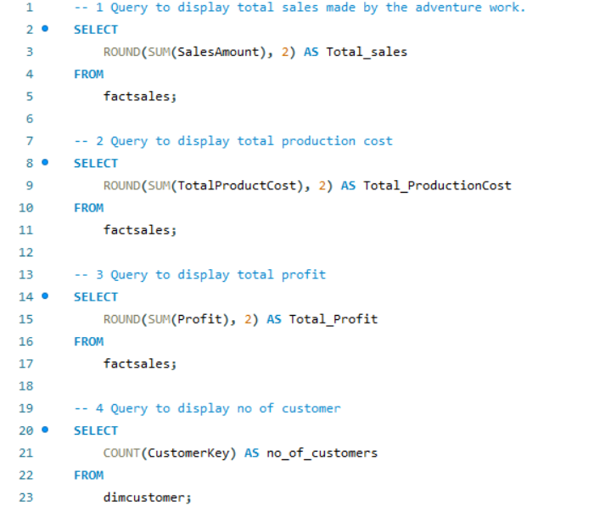
MYSQL QUERIES

Slide 17
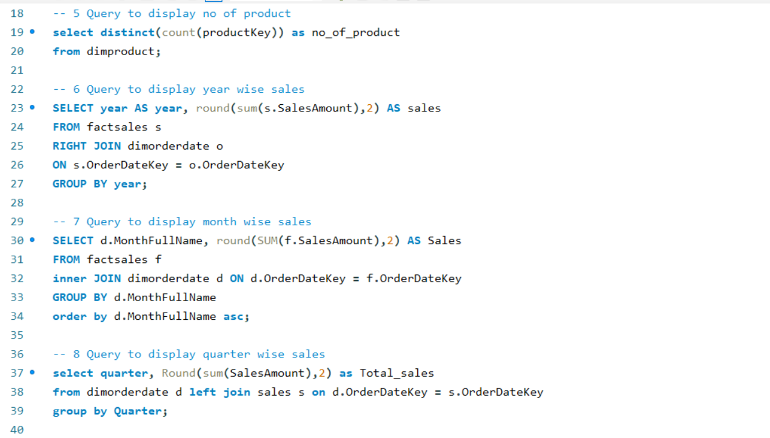
MYSQL QUERIES

Slide 18
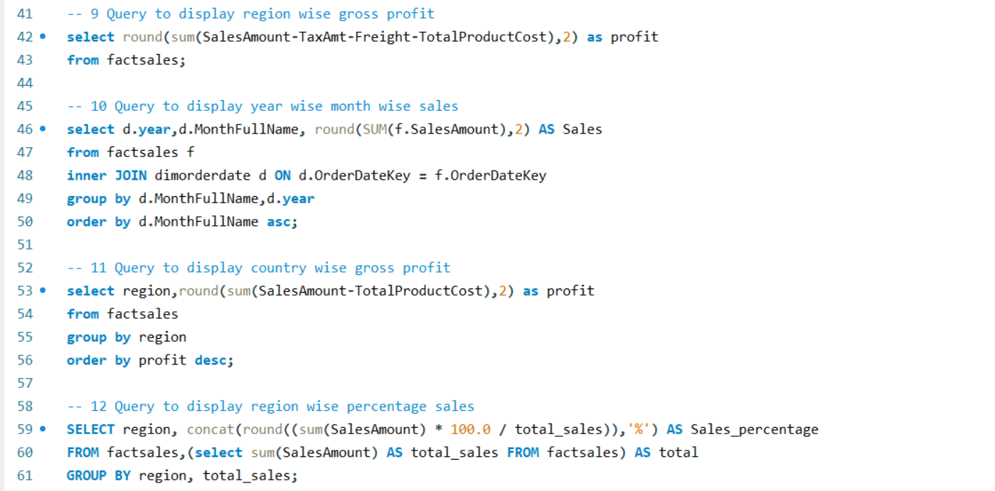
MYSQL QUERIES

Slide 19
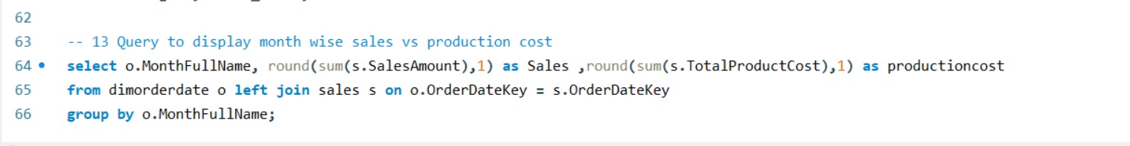
MYSQL QUERIES

Slide 20
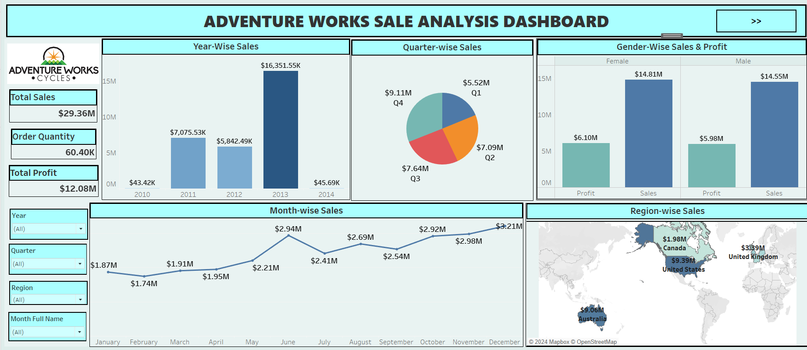
TABLEAU DASHBOARD

Slide 21
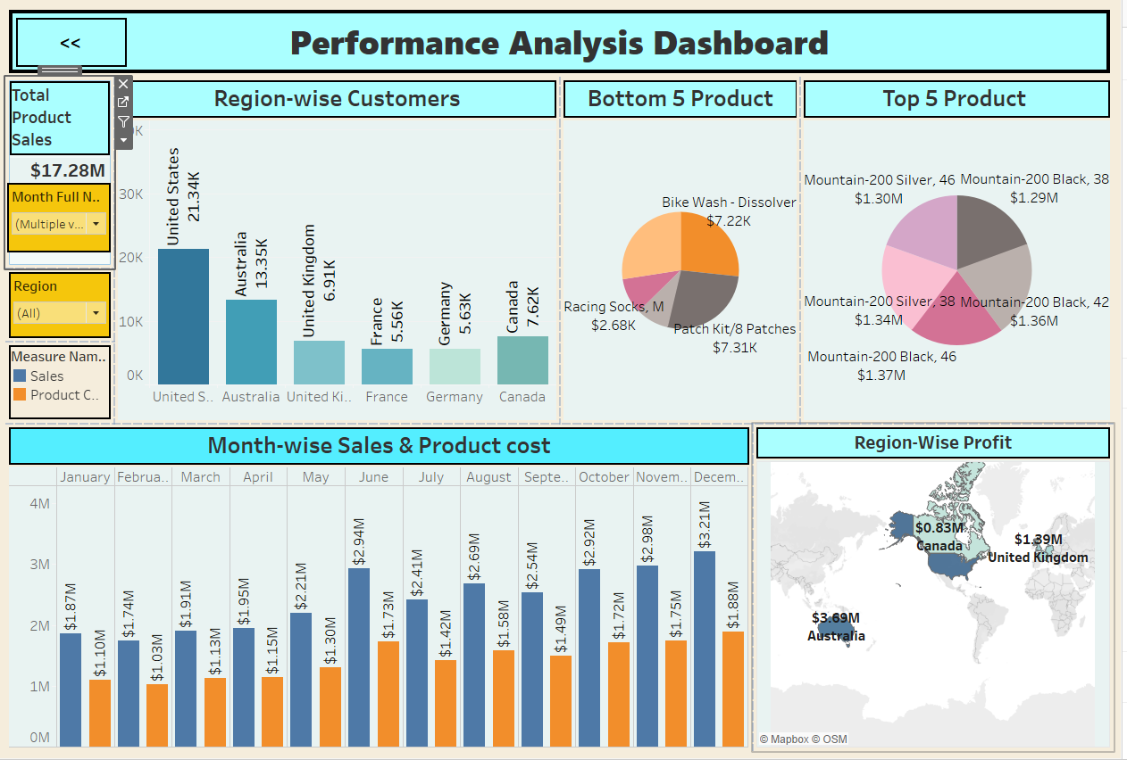
TABLEAU DASHBOARD

Slide 22

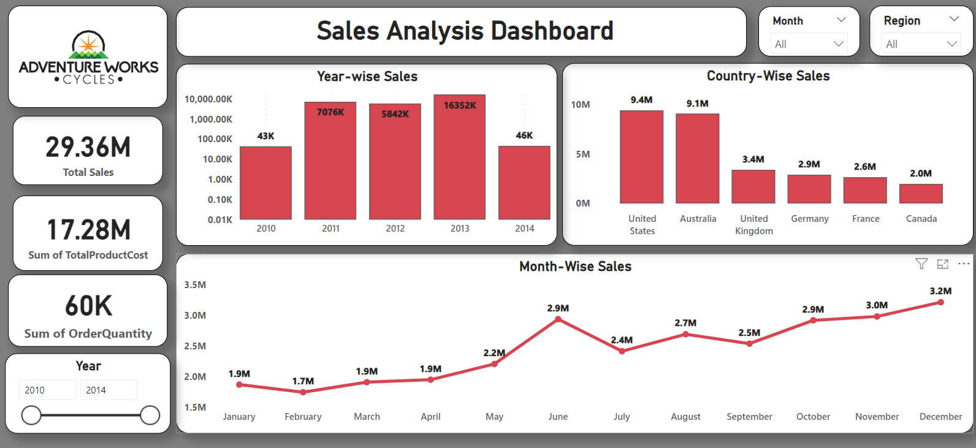
POWER BI DASHBOARD

Slide 23
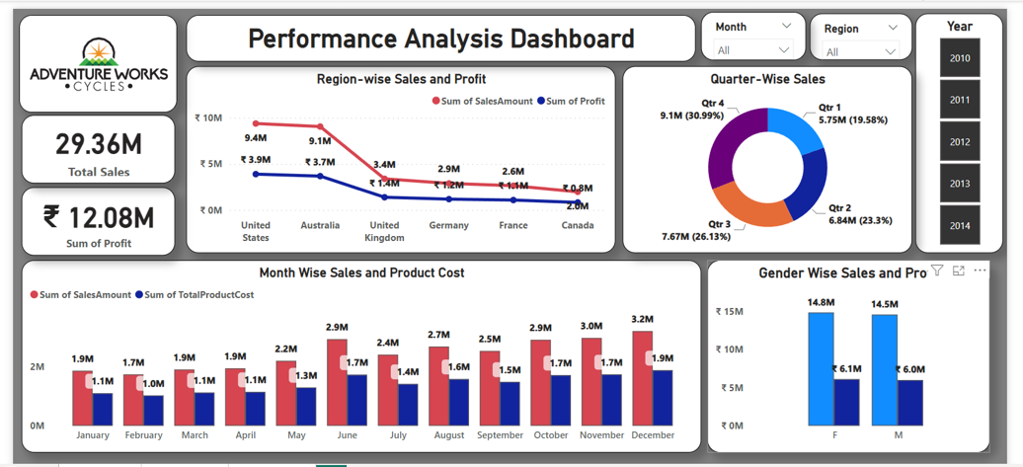
POWER BI DASHBOARD

Slide 24
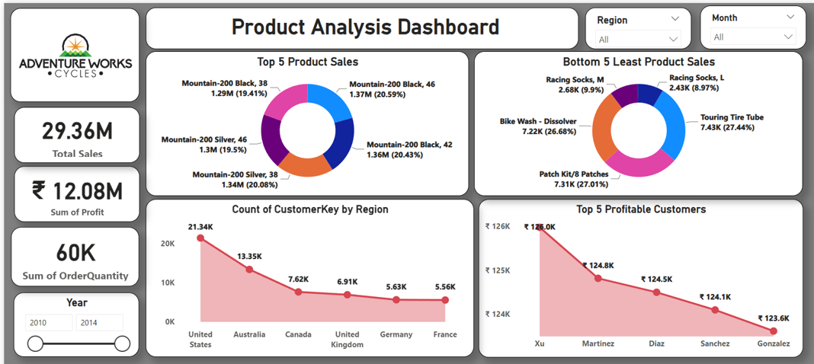
POWER BI DASHBOARD

Slide 25











CONCLUSION
The project has successfully uncovered significant trends and patterns in the sales portfolio, offering actionable insights that can be used to refine sales strategies, identify the sales trends, and improve customer targeting. The use of tools like Excel, Tableau, Power BI, and SQL was critical in preparing comprehensive dashboards that facilitate informed decision-making.

Slide 26
CONCLUSION
Business Impact: These dashboards empower Adventure Works Cycles with actionable insights, enabling data-driven decisions that can enhance profitability, optimize product offerings, and strategically expand into underperforming regions.

Slide 27






THANK YOU

